Slide 1


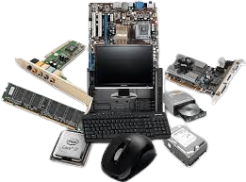
“Consumer Goods”
Ad-Hoc Insights for Strategic Advantage
Presented by
Amit Kumar Barik

Slide 2
AGENDA
Objective
Challenge
Procedure
Findings
Overview

Slide 3
Objective
AtliQ Hardware, a global computer hardware manufacturer based in India, aims to enhance its data analytics capabilities to support informed decision-making. The Director of Data Analytics, Tony Sharma, plans to conduct an SQL challenge to assess both technical skills and soft skills of potential junior data analysts. This project involves ten specific ad hoc requests, reflecting real-world challenges, for candidates to provide valuable insights.

Slide 4
Challenge
The primary challenge is to process and analyze data from six main tables, encompassing customer data, product information, gross price details, manufacturing costs, pre-invoice deductions, and monthly sales data. The goal is to generate actionable insights that can inform strategic decisions and drive business growth.

Slide 5
Procedure
Data Extraction: Extract relevant data from six main tables:
dim_customer
dim_product
fact_gross_price
fact_manufacturing_cost
fact_pre_invoice_deductions
fact_sales_monthly.
Data Analysis: Perform SQL queries to derive insights from the data based on the provided ad hoc requests.
Report Generation: Compile the findings into a comprehensive report, highlighting key insights and strategic recommendations.

Slide 6
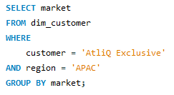

Q1. Provide the list of markets in which customer "AtliQ Exclusive" operates its business in the APAC region.
Query
Result

Slide 7
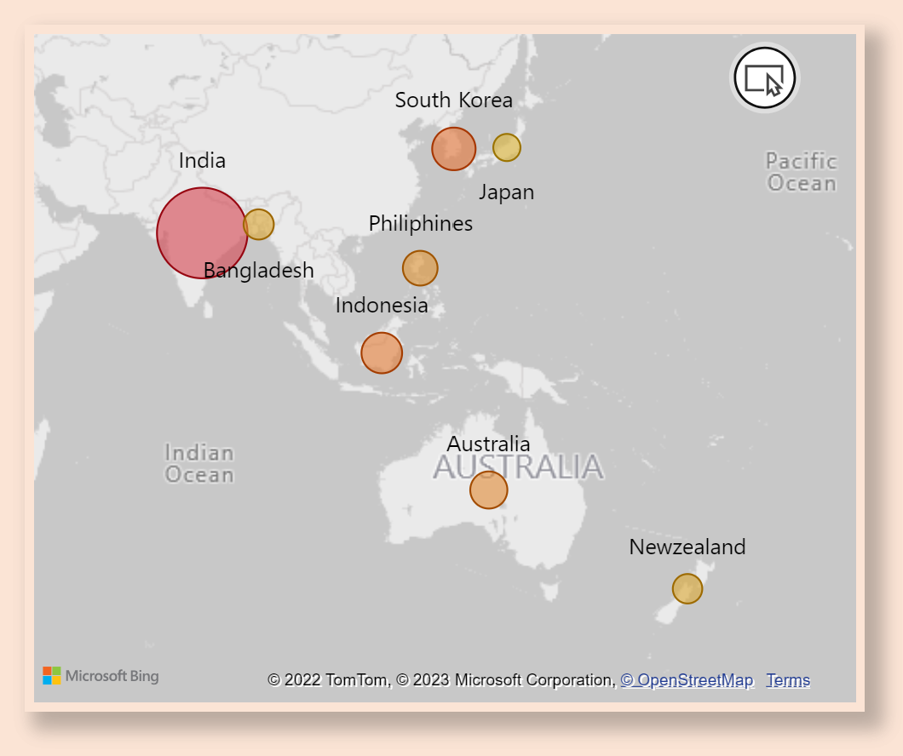
Insights
Representation
- AtliQ Exclusive has successfully expanded its reach into eight primary markets across the APAC region.
- This expansion reflects a robust market presence.
- The company has shown adaptability to diverse cultural and economic contexts in the Asia-Pacific area.

Slide 8
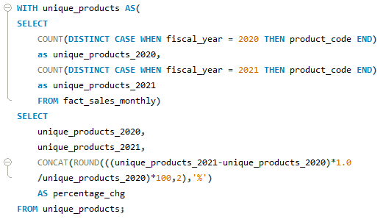

Q2. What is the percentage of unique product increase in 2021 vs. 2020?
Query
Result

Slide 9
Insights
Representation
- During the fiscal year 2020, our product count stood at 245.
- By FY 2021, the product count had risen to 334.
- This represents a growth of 36.33% in unique products from one year to the next.
36.33%
Common unique products

Slide 10
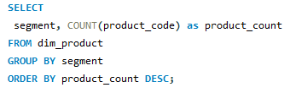
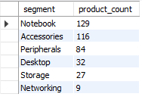
Q3. Provide a report with all the unique product counts for each segment and sort them in descending order of product counts.
Query
Result

Slide 11
Insights
Representation
- AtliQ Hardware offers a comprehensive range of products in the Notebook, Peripherals, and Accessories segments.
- The "Notebook" segment has the highest product count, with 129 products, while the "Networking" segment has the smallest product count with only 9 products.
- Recognizing the strategic imperative to diversify our product portfolio, we aim to expand into the Desktop, Networking, and Storage markets.

Slide 12
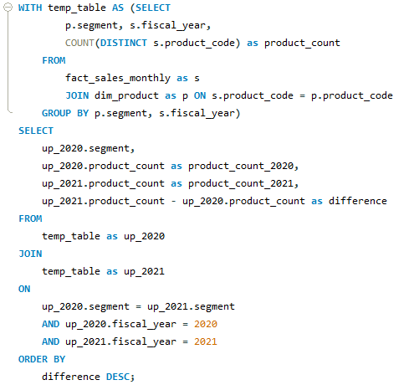
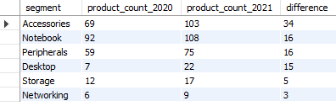
Q4. Which segment had the most increase in unique products in 2021 vs 2020?
Query
Result

Slide 13
Insights
Representation
- In 2021, AtliQ Hardware placed a primary emphasis on extending its footprint in the accessories market, unveiling a total of 34 new accessory products.
- These insights suggest a general trend of product portfolio growth, particularly in the "Accessories" and "Notebook" segments, indicating a strategy to cater to a broader range of customer preferences.
- This strategic approach reflects AtliQ Hardware's commitment to adapt to evolving consumer demands and enhance its market competitiveness.

Slide 14
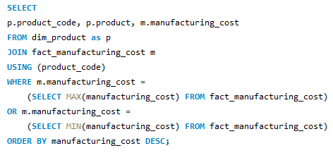

Q5. Get the products that have the highest and lowest manufacturing costs.
Query
Result

Slide 15


Insights
Representation
- The product with the maximum manufacturing cost is AQ Home Allin1 Gen2.
- Conversely, the product with the minimum manufacturing cost is AQ Master Wired X1 MS.
- These insights provide valuable data for optimizing production processes and pricing strategies to maximize profitability and competitiveness.

Slide 16
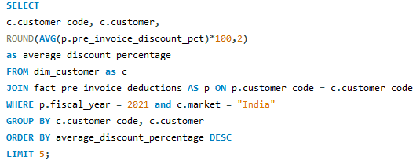
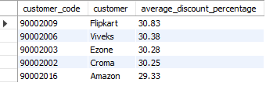
Q6. Generate a report which contains the top 5 customers who received an average high pre_invoice_discount_pct for the fiscal year 2021 and in the Indian market.
Query
Result

Slide 17
Insights
Representation
- Flipkart maintains the status of being the most heavily discounted customer in the Indian market, boasting a pre-invoice discount percentage of 30.83%.
- In 2021, AtliQ applied approximately equivalent pre-invoice discount percentages to each of its top 5 clients, ensuring fairness and consistency in discount offerings across its client base.
- This strategic approach helps maintain strong relationships with key clients while also optimizing revenue generation and market competitiveness.

Slide 18
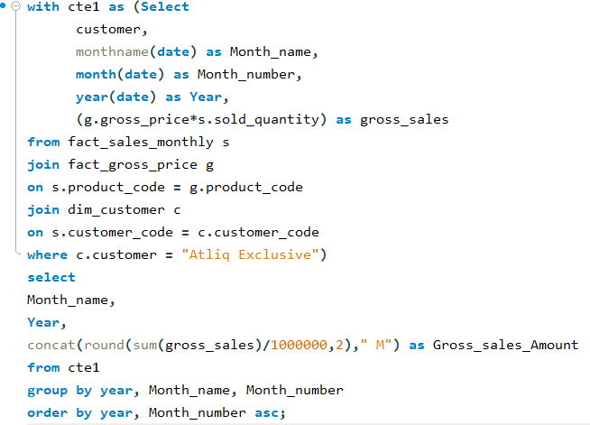
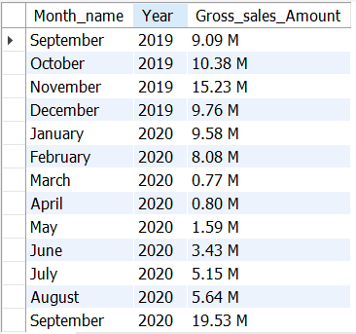
Q7. Get the complete report of the Gross sales amount for the customer “AtliQ Exclusive” for each month. This analysis helps to get an idea of low and high-performing months and take strategic decisions.
Query
Result

Slide 19
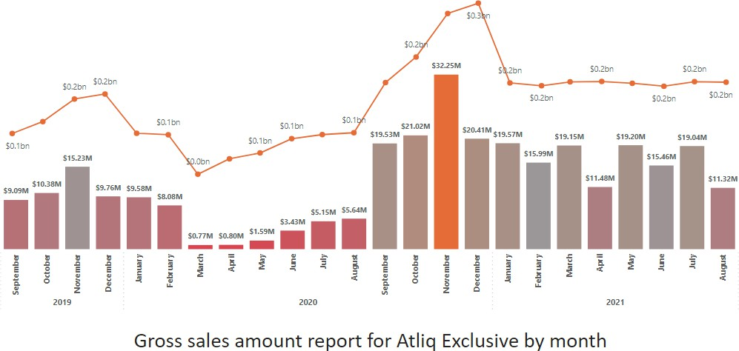
Insights
- AtliQ Exclusive achieved its peak sales in November 2020, while March 2020 marked the lowest point in sales.
- The decrease in sales from March to August can be linked to the repercussions of COVID-19, reflecting the pandemic's impact on business operations.
- Nevertheless, there is a positive outlook as sales have steadily recovered post-pandemic, demonstrating resilience and surpassing the levels observed in 2020.
Representation

Slide 20
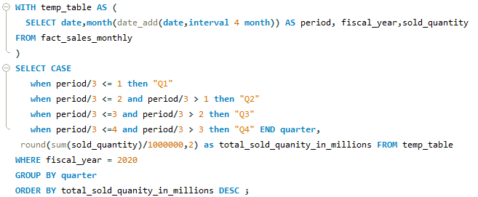

Q8. In which quarter of 2020, got the maximum total_sold_quantity?
Query
Result

Slide 21
Insights
Representation
- During the third quarter of fiscal year 2020 (March, April, and May), characterized by the peak of COVID-19 and extensive lockdowns affecting businesses, the quantity sold sharply declined to 2.1 million.
- Interestingly, there was a notable surge in demand for computer accessories during this period, likely driven by a large number of students either beginning or continuing their coursework online.
- This increased demand probably played a role in the early rebound observed in the fourth quarter, indicating the adaptability of consumer preferences amidst changing circumstances and providing insights for future market strategies.
Quarters FOR FISCAL YEAR 2020
Q1
SEP’19
OCT’19
NOV’19
7.01M
Q2
DEC’19
JAN’20
FEB’20
6.65M
Q3
MAR’20
APR’20
MAY’20
2.08M
Q4
JUN’20
JUL’20
AUG’20
5.04M

Slide 22
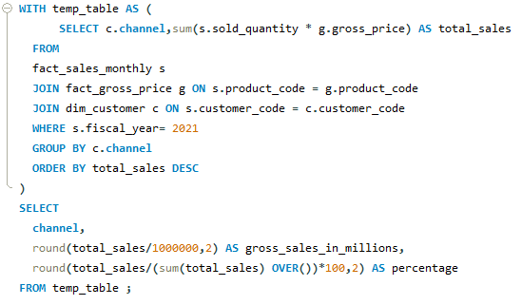

Q9. Which channel helped to bring more gross sales in the fiscal year 2021 and the percentage of contribution?
Query
Result

Slide 23



Insights
Representation
- The "Retailer" channel accounts for the majority of sales, contributing to 73.22% of gross sales, indicating its pivotal role as the primary revenue driver.
- The "Direct" channel also plays a significant role, representing 15.47% of gross sales, highlighting its importance in capturing direct consumer demand.
- Additionally, the "Distributor" channel contributes 11.31% of gross sales, showcasing its contribution to overall revenue diversification and market reach.
retailer
direct
distributor
3708.46m (73.21 %)
784.14m (15.48 %)
572.86m
(11.31 %)

Slide 24
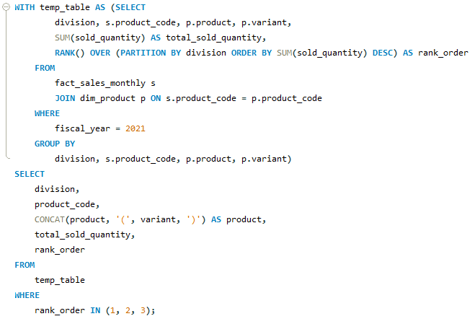
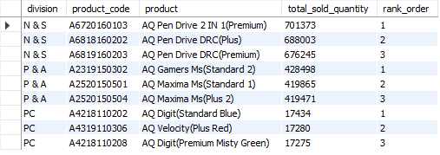
Q10. Get the Top 3 products in each division that have a high total_sold_quantity in the fiscal_year 2021?
Query
Result

Slide 25
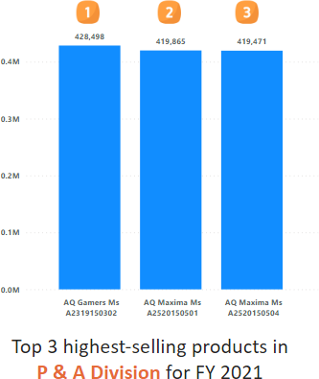
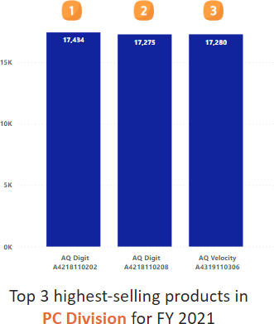
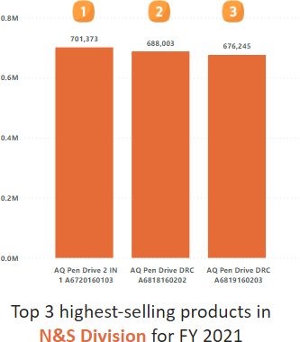
Insights
- The three best-selling products in the N & S division were pen drives, reflecting a strong consumer preference for pen drives and related items within this division.
- In the P & A division, the top three best-selling products were pen mice, highlighting the division's specialization in gaming-related products and its appeal to a specific customer niche.
- Within the PC division, laptops emerged as the top three best-selling products, indicating a focus on PC-related products and underscoring the division's specialization in the computing niche.
Representation

Slide 26
Overview
AtliQ Hardware is committed to leveraging data analytics to drive strategic decisions. By focusing on real-world challenges, the company aims to enhance its analytical capabilities and support its growth in the competitive computer hardware market. The insights generated from this challenge will inform future strategies and operational improvements, ultimately contributing to the company's success.

